Slide 1

NAMASkAR MUDRA
To achieve the divine power and to formulate positive thoughts there
are 5 basic namaskar postures
Araham posture – om hring namo arahantanam
Sidh posture – om hring namo sidhanam
Acharya posture – om hring namo ayariyanam
Upadhayay posture – om hring namo uvajjhayanam
Muni posture – om hring namo loye savvsahunam
Eso panch namuaro,
Savv pavapanasano
Mangalanam ch savvesin ,
Padhamam havai mangalam

Slide 2
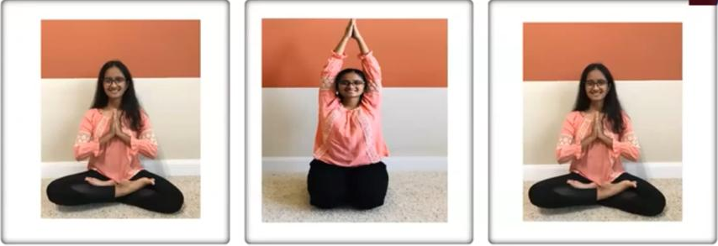
OM HRING NAMO ARAHANTANAM
PROCEDURE
As you inhale take your hands above your head
As you exhale bring your hands back to prayer position
Benefits
Increases concentration power
Helps in reducing hand pain

Slide 3
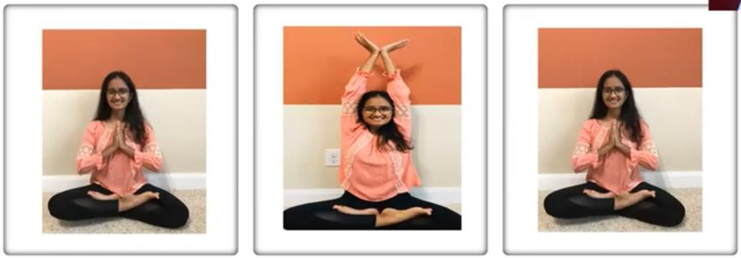
OM HRING NAMO SIDDHANAM
PROCEDURE
As you inhale take your hands above your head and form a lotus position
As you exhale bring your hands to prayer position
Benefits
Reduces stress
Reduces stomach fat

Slide 4
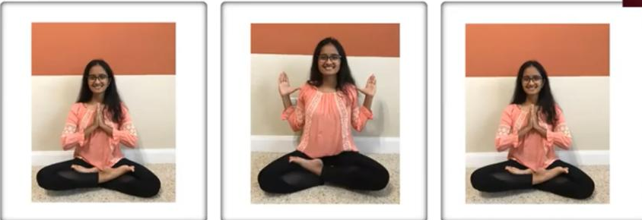
OM HRING NAMO AYARIYANAM
PROCEDURE
As you inhale bring your hand next to your shoulder
As you exhale bring your hands bac to prayer position
Benefits
Reduces fear
Reduces stress in shoulder
Strengthens heart and lungs

Slide 5
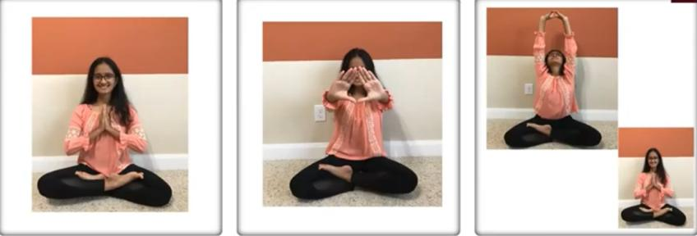
OM HRING NAMO UVVAJHAYANAM
PROCEDURE
As you inhale bring your hands up, form a diamond and look through it.
As you exhale bring your hands back to prayer position
Benefits
Reduces stress in neck
Helps with eyesight
Reduces back ache

Slide 6
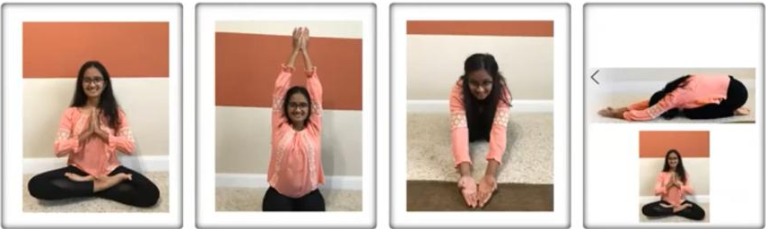
OM HRING NAMO LOYE SAVVSAHOONAM
PROCEDURE
As you inhale bring your hand next to your shoulder
As you exhale bring your hands back to prayer position
Benefits
Reduces fear
Reduces stress in shoulder
Strengthens heart and lungs

